Slide 1

London Metropolitan University
PT5000 · Cardiorespiratory Practice 3
Pathophysiology &
Clinical Presentation
Restrictive & infective lung disease
Kola Akinlabi,BSc (Hons), MSc Adv. cardiorespi (UCL), Pgcet NMP, MPhil, PhD
Clinical Lead Respiratory, Pulm Rehab and Long COVID
CLCH NHS Trust
Tue 3 Feb · 10:00–11:00
BSc Year 2
Lecture Pack
Notes:
[Sources]
- London Metropolitan University brand colour palette (black #231f20) and logo rules: https://www.londonmet.ac.uk/brand/guidelines/colour/
- London Metropolitan University logo rules: https://www.londonmet.ac.uk/brand/guidelines/logos/
- Logo image (PNG derived from SVG): https://upload.wikimedia.org/wikipedia/de/thumb/8/88/London_Metropolitan_University_logo.svg/1280px-London_Metropolitan_University_logo.svg.png
[/Sources]

Slide 2
Learning outcomes
Tue 3 Feb · 10:00–11:00
By the end of this session, you should be able to:
Describe major causes of restrictive lung disease (parenchymal vs extra-pulmonary).
Explain key pathophysiology: ↓compliance, ↓lung volumes, V/Q mismatch and diffusion limitation.
Summarise pathophysiology of common infective lung conditions (e.g., pneumonia, bronchiectasis exacerbation, TB).
Recognise common clinical presentations and “red flags” indicating clinical deterioration.
PT5000 · CRP 3 · BSc Physiotherapy (Year 2)
Notes:
[Sources]
- Restrictive lung disease overview and physiological consequences: https://www.ncbi.nlm.nih.gov/books/NBK560880/
- ERS/ATS interpretive strategies for routine lung function tests (restriction concept): https://publications.ersnet.org/content/erj/60/1/2101499
- WHO TB consolidated guidelines (treatment & care module landing page): https://www.who.int/publications/i/item/9789240107243
[/Sources]

Slide 3
What do we mean by “restrictive” vs “infective”?
Tue 3 Feb · 10:00–11:00
Restrictive patterns (mechanics)
Infective lung disease (gas exchange + inflammation)
Reduced total lung capacity (TLC) → reduced vital capacity (VC) and smaller operating volumes.
Often preserved or ↑ FEV1/FVC ratio; confirm restriction with lung volumes.
Causes may be parenchymal (ILD/fibrosis) or extra-pulmonary (chest wall, obesity, neuromuscular, pleural).
Clinical consequences and physio impact: ↑ work of breathing, exertional desaturation, exercise intolerance.
Alveolar/airway inflammation + exudate → impaired ventilation, diffusion and V/Q matching.
Examples: community-acquired pneumonia, aspiration pneumonia, bronchiectasis exacerbation, tuberculosis.
Systemic response: fever, tachycardia, raised inflammatory markers; severe cases may progress to sepsis/respiratory failure.
Clinical consequences and Physio impact: mobilisation tolerance, secretion load, oxygen needs, fatigue.
PT5000 · CRP 3 · BSc Physiotherapy (Year 2)
Notes:
[Sources]
- Restriction and PFT evaluation (TLC/FEV1/FVC): https://www.ncbi.nlm.nih.gov/books/NBK560880/
- ERS/ATS interpretive strategies (lung volumes + DLCO concepts): https://vvlr-afp.be/wp-content/uploads/2025/03/ERS-ATS-technical-standard-on-interpretive-strategies-for-routine-lung-function-tests_ERJ_2021.pdf
- BTS bronchiectasis guideline (infective exacerbations + airway clearance section): https://thorax.bmj.com/content/thoraxjnl/74/suppl_1/1.full.pdf
[/Sources]

Slide 4
Restriction: from pathology to symptoms
Tue 3 Feb · 10:00–11:00
Concept map (simplified)
Aetiology
Clinical presentation
ILD / fibrosis
Pleural disease
Chest wall (kyphoscoliosis)
Neuromuscular weakness
Obesity hypoventilation
Dyspnoea (esp. exertional)
Dry cough (ILD)
Fine inspiratory crackles
Exertional desaturation
Fatigue / reduced exercise capacity
Primary physiological change
↓ compliance / ↓ expansion
↓ TLC & VC
↑ RR to maintain ventilation
Possible ↓ DLCO (parenchymal)
Complications / red flags
Acute hypoxaemic RF
Rapidly ↑ O2 requirement
Haemodynamic instability
New confusion
Severe work of breathing
PT5000 · CRP 3 · BSc Physiotherapy (Year 2)
Notes:
[Sources]
- Restrictive lung disease evaluation and typical PFT features: https://www.ncbi.nlm.nih.gov/books/NBK560880/
- BTS/ACPRC respiratory physiotherapy guideline (restrictive lung conditions section): https://www.brit-thoracic.org.uk/document-library/guidelines/physiotherapy/btsacprc-guidelines-for-physiotherapy-management-of-the-adult-medical-spontaneously-breathing-patient/
[/Sources]

Slide 5
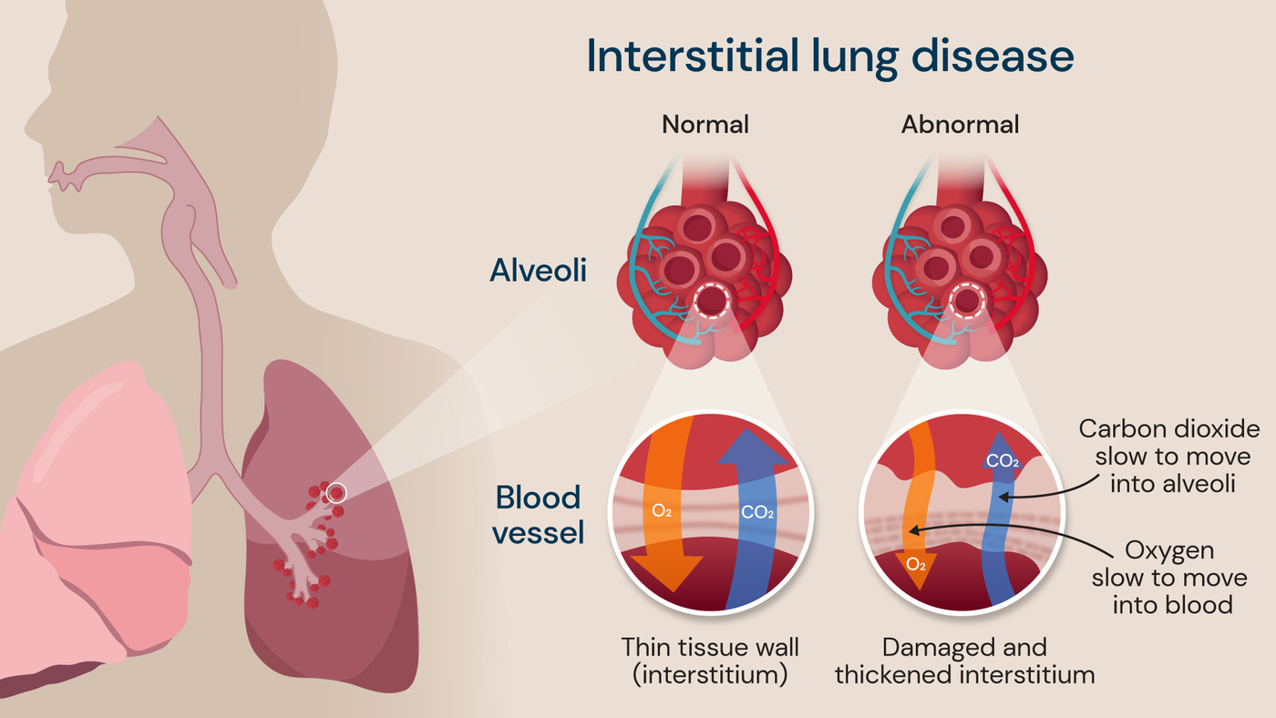
Interstitial lung disease (ILD)
refers to a group of over 100 chronic lung disorders characterized by inflammation and irreversible scarring (fibrosis) of the lung tissue, specifically the alveoli, which impairs oxygen transfer to the bloodstream.
Common types include idiopathic pulmonary fibrosis (IPF), sarcoidosis, and hypersensitivity pneumonitis. Key symptoms include progressive, exertional shortness of breath, a dry, non-productive cough, and severe fatigue.
Causes and Risk Factors
Environmental/Occupational Exposure: Long-term exposure to silica, asbestos, coal dust, or mold can lead to ILD.
Autoimmune Diseases: Conditions like rheumatoid arthritis, scleroderma, and lupus.
Medications and Radiation: Certain drugs (e.g., chemotherapy, heart medications) and chest radiation.
Idiopathic: Often, no clear cause is identified (e.g., in IPF).
Risk Factors: Primarily affects adults, with risk increasing with age.
Symptoms and Diagnosis
Symptoms: Shortness of breath (especially with activity), a dry, hacking cough, unexplained weight loss, fatigue, and sometimes clubbing (widening) of fingers or toes.
Diagnosis: Often involves high-resolution CT scans (HRCT),
lung function tests (spirometry)
blood tests to rule out autoimmune causes, and occasionally a lung biopsy.

Slide 6
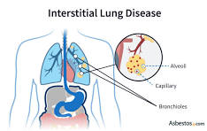
Stages and Prognosis
ILD is not typically staged in a simple, linear manner, but rather categorized by its progression, which can be rapid or gradual.
Some forms are progressive and lead to respiratory failure, with IPF having a median survival of 2.5 to 3.5 years if left untreated, according to a report in JAMA.
Treatment and Management
While most damage is irreversible, treatment focuses on reducing inflammation, slowing progression, and managing symptoms.
Medication:
Immunosuppressants
anti-inflammatory agents
and antifibrotic medications (specifically for IPF).
Supportive Therapy ( mostly Physio): Supplemental oxygen, pulmonary rehabilitation, and smoking cessation.
Advanced Cases: In severe, progressive cases, a lung transplant may be considered.

Slide 7
Infection: from pathogen to consolidation
Tue 3 Feb · 10:00–11:00
Concept map (simplified)
Trigger
Clinical presentation
Pathogen (viral/bacterial)
Aspiration
Impaired clearance
Underlying lung disease
Fever, cough ± sputum
Pleuritic pain
Crackles / bronchial breathing
Tachypnoea, hypoxia
Functional decline
Local response
Inflammation
Mucus/exudate
Alveolar filling
Airway narrowing
Red flags
Sepsis features
SpO2 falling on O2
Rising RR/HR
New confusion
Escalating fatigue / inability to mobilise
Gas exchange impact
V/Q mismatch
Shunt physiology
↑ work of breathing
Hypoxaemia ± hypercapnia
PT5000 · CRP 3 · BSc Physiotherapy (Year 2)
Notes:
[Sources]
- NICE pneumonia guideline overview (assessment/treatment context): https://www.nice.org.uk/guidance/ng250
- BTS pneumonia guideline hub (background): https://www.brit-thoracic.org.uk/quality-improvement/guidelines/pneumonia-adults/
[/Sources]

Slide 8
Pulmonary function patterns (overview)
Tue 3 Feb · 10:00–11:00
Indicative patterns (interpret in context; confirm restriction with lung volumes).
Notes: (1) Restriction = ↓TLC with preserved ratio; (2) DLCO tends to fall in parenchymal ILD, but may be normal in extra-pulmonary restriction.
PT5000 · CRP 3 · BSc Physiotherapy (Year 2)
Notes:
[Sources]
- Restrictive pattern confirmation with TLC and preserved ratio: https://www.ncbi.nlm.nih.gov/books/NBK560880/
- ERS/ATS interpretive strategies for routine lung function tests (volumes/DLCO interpretation): https://publications.ersnet.org/content/erj/60/1/2101499
[/Sources]

Slide 9
Clinical clues: restrictive vs infective (at the bedside)
Tue 3 Feb · 10:00–11:00
Key contrasts (high-yield)
Domain
Typical features / examples
Onset
Restrictive: often gradual (ILD) or chronic; Infective: acute–subacute (days) or exacerbation pattern.
Cough/sputum
Restrictive ILD: usually dry; Infective: productive sputum common (but not universal).
Auscultation
Restrictive ILD: fine end-inspiratory crackles; Infective: coarse crackles, bronchial breathing, wheeze if airway involvement.
Systemic features
Restrictive: weight loss/fatigue possible; Infective: fever/rigors, raised CRP/WCC.
Oxygenation
Both may desaturate; infective disease may show rapidly changing O2 requirement.
Imaging
Restrictive: reticulation/ground-glass on HRCT; Infective: consolidation on CXR/CT.
PT5000 · CRP 3 · BSc Physiotherapy (Year 2)
Notes:
[Sources]
- Restrictive lung disease clinical overview: https://www.ncbi.nlm.nih.gov/books/NBK560880/
- NICE pneumonia guideline (diagnosis and imaging emphasis): https://www.nice.org.uk/guidance/ng250
[/Sources]

Slide 10
Wrap-up: what should you remember?
Tue 3 Feb · 10:00–11:00
Mechanisms
Clinical priorities for physiotherapists
Restriction = volume problem (↓TLC) often driven by ↓ compliance or reduced chest expansion.
Infection = gas exchange and systemic inflammation problem; can coexist with chronic disease.
Clinical pattern recognition is useful, but objective tests and imaging confirm diagnosis.
Identify red flags and escalate early (deteriorating oxygenation, RR/HR, confusion).
Optimise oxygenation and mobilisation tolerance; manage secretions when present.
Use structured assessment and document response to interventions.
PT5000 · CRP 3 · BSc Physiotherapy (Year 2)
Notes:
[Sources]
- ERS/ATS interpretive strategies for routine lung function tests: https://publications.ersnet.org/content/erj/60/1/2101499
- Restrictive lung disease overview (NCBI Bookshelf): https://www.ncbi.nlm.nih.gov/books/NBK560880/
- NICE NG250 (pneumonia): https://www.nice.org.uk/guidance/ng250
- BTS bronchiectasis guideline (airway clearance): https://thorax.bmj.com/content/thoraxjnl/74/suppl_1/1.full.pdf
- ATS 6MWT guideline: https://www.thoracic.org/statements/resources/pfet/sixminute.pdf
- ATS/ERS pulmonary rehabilitation statement: https://www.thoracic.org/statements/resources/respiratory-disease-adults/atserspr0606.pdf
[/Sources]

Slide 11
Key references (selected)
Tue 3 Feb · 10:00–11:00
Martinez-Pitre PJ, et al. Restrictive Lung Disease. StatPearls (updated 2023). (NCBI Bookshelf).
Stanojevic S, et al. ERS/ATS technical standard on interpretive strategies for routine lung function tests. Eur Respir J. 2022;60:2101499.
NICE. Pneumonia: diagnosis and management. NG250 (updated 2025).
Hill AT, et al. BTS guideline for bronchiectasis in adults. Thorax. 2019;74(Suppl 1):1–69.
WHO. Consolidated TB guidelines: module 4 (treatment and care). 2025.
West JB, Luks AM. West's Respiratory Physiology: The Essentials. 11th ed. Wolters Kluwer; 2021.
Broaddus VC, et al. Murray & Nadel's Textbook of Respiratory Medicine. 7th ed. Elsevier; 2022.
Pryor JA, Prasad SA. Cardiorespiratory Physiotherapy: Adults and Paediatrics. 5th ed. Elsevier; 2016.
Hillegass E. Essentials of Cardiopulmonary Physical Therapy. 5th ed. Elsevier; 2022.
PT5000 · CRP 3 · BSc Physiotherapy (Year 2)
Notes:
[Sources]
- Restrictive Lung Disease (NCBI Bookshelf): https://www.ncbi.nlm.nih.gov/books/NBK560880/
- ERS/ATS interpretive strategies (ERJ): https://publications.ersnet.org/content/erj/60/1/2101499
- NICE NG250: https://www.nice.org.uk/guidance/ng250
- BTS bronchiectasis guideline PDF: https://thorax.bmj.com/content/thoraxjnl/74/suppl_1/1.full.pdf
- WHO TB module 4 landing page: https://www.who.int/publications/i/item/9789240107243
- John B. West video lectures: https://pulmonary.ucsd.edu/research/labs-centers/west/video-lectures.html
[/Sources]

Slide 12
Student resources & practice tasks
Tue 3 Feb · 10:00–11:00
Suggested self-study (60–90 min)
Read: ERS/ATS (2022) “Interpretive strategies” – skim sections on restriction and DLCO.
Practice: interpret 5 anonymised spirometry reports (identify likely pattern + next test).
Watch: John B. West respiratory physiology video lectures (UCSD).
Review: NICE NG250 visual summary for CAP severity assessment.
PT5000 · CRP 3 · BSc Physiotherapy (Year 2)
Notes:
[Sources]
- Restrictive Lung Disease (NCBI Bookshelf): https://www.ncbi.nlm.nih.gov/books/NBK560880/
- ERS/ATS interpretive strategies (ERJ): https://publications.ersnet.org/content/erj/60/1/2101499
- NICE NG250: https://www.nice.org.uk/guidance/ng250
- BTS bronchiectasis guideline PDF: https://thorax.bmj.com/content/thoraxjnl/74/suppl_1/1.full.pdf
- WHO TB module 4 landing page: https://www.who.int/publications/i/item/9789240107243
- John B. West video lectures: https://pulmonary.ucsd.edu/research/labs-centers/west/video-lectures.html
[/Sources]

